Slide 1
Notebook for EpiMethods
Advanced Epidemiological Methods

Slide 2
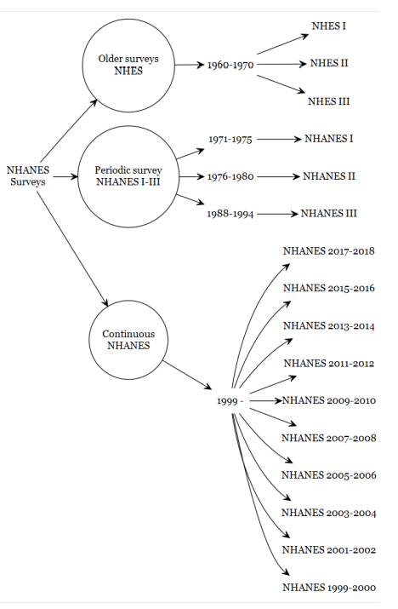
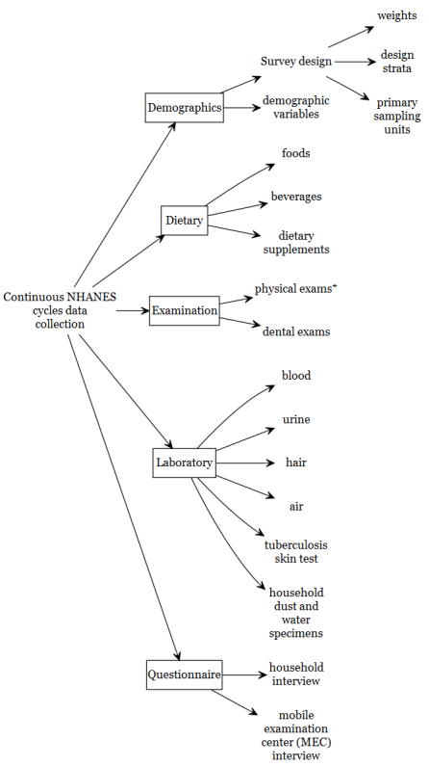
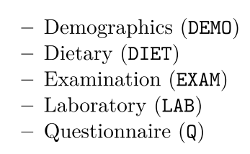

Slide 3
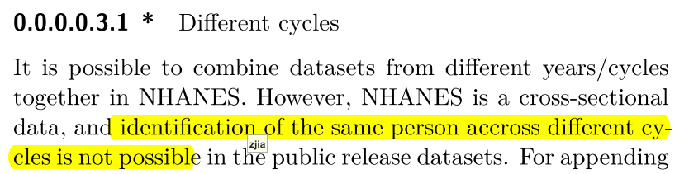
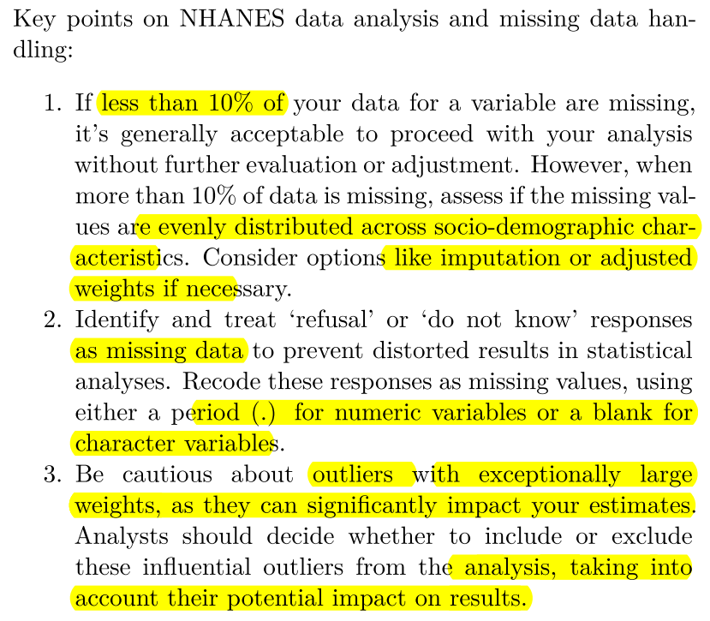
https://wwwn.cdc.gov/nchs/nhanes/tutorials/weighting.aspx

Slide 4


Slide 5
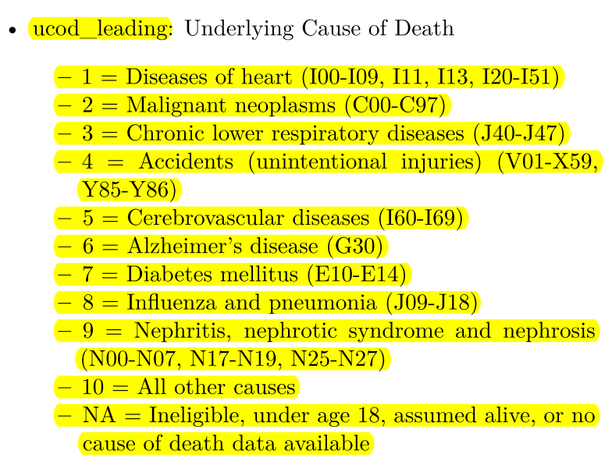
https://ftp.cdc.gov/pub/Health_Statistics/NCHS/datalinkage/linked_mortality/

Slide 6
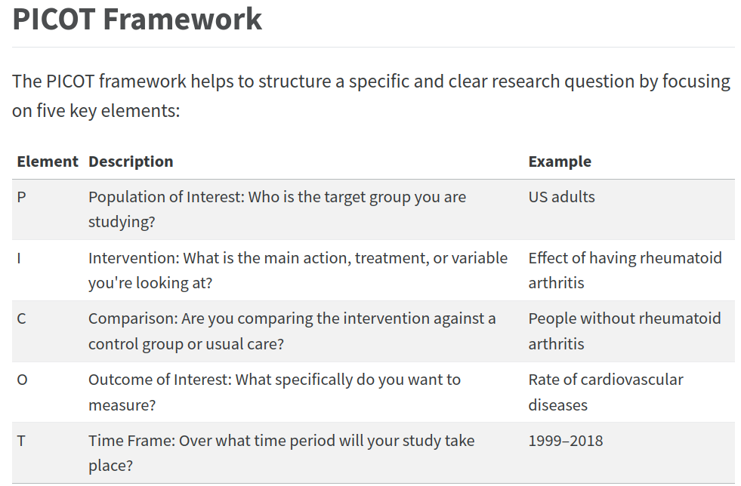


Slide 7
A predictive model for Diastolic blood pressure from 2013-14 NHANES data.
outcome (Diastolic blood pressure)
Covariates: (that are known to influence this outcome) )
• sex
• age
• race
• marital status
• Systolic blood pressure
• smoking
• alcohol
• education level
• poverty income ratio
• Sodium intake (mg)
• Potassium intake (mg)
survey features: weights, strata, cluster
NHANES 2015-2016

Slide 8
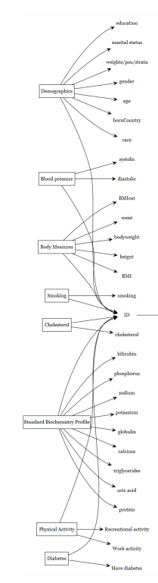
relationship between diabetes and cholesterol

Slide 9
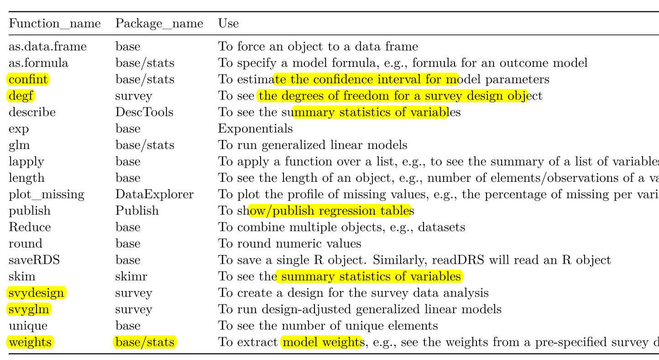

Slide 10
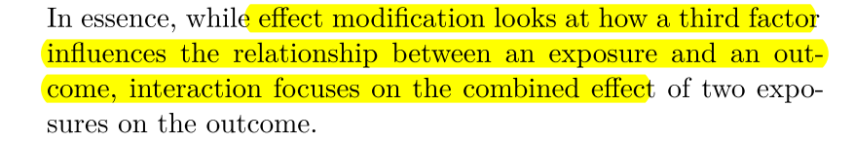
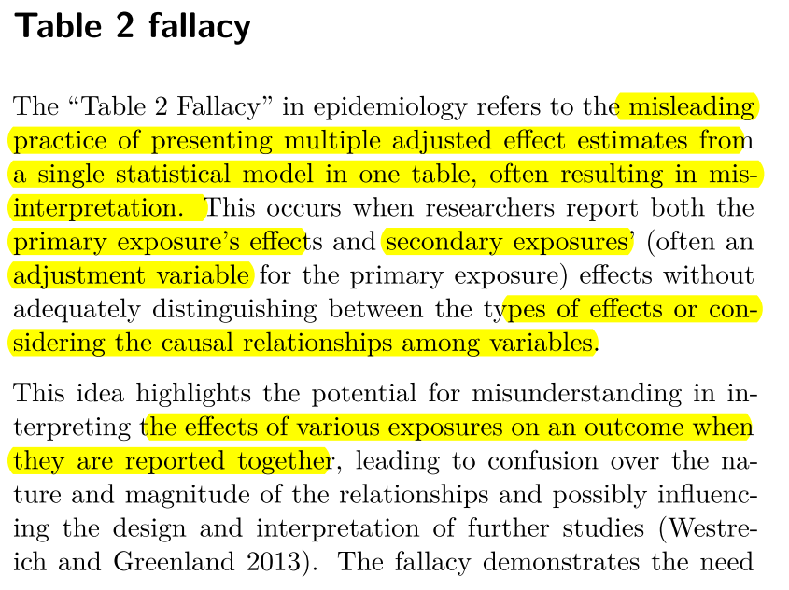
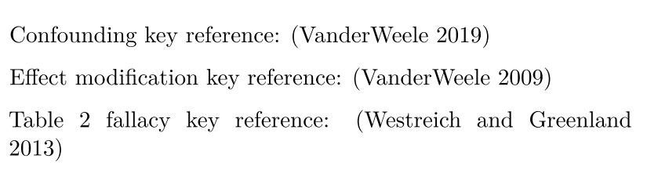

Slide 11
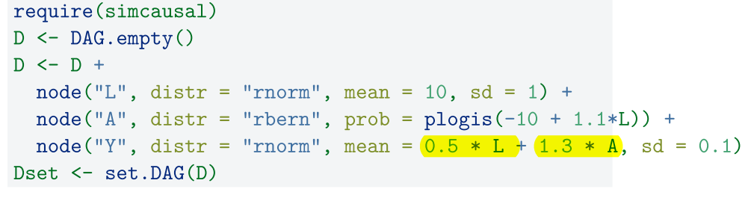
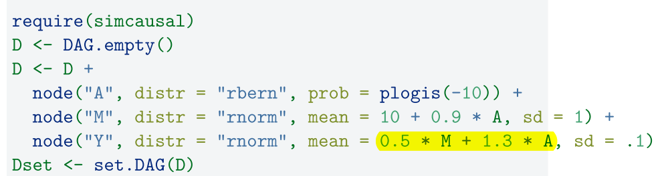
Confounding
Mediator:
Mediators play a crucial role in understanding how a treatment variable aff ects an outcome. A mediator variable lies in the pathway between the treatment and outcome, essentially transmitting or explaining the eff ect of the treatment variable.
the true direct and indirect effects when a mediator is present

Slide 12
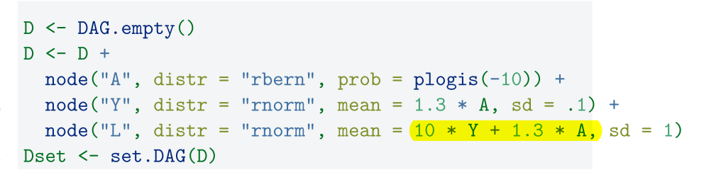
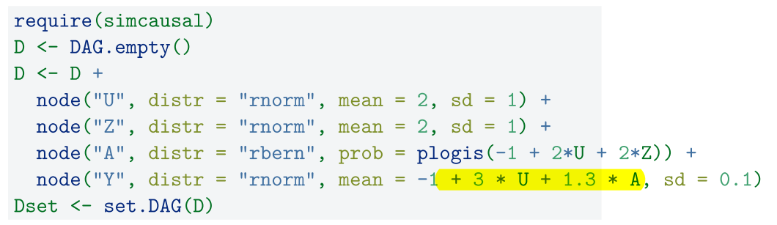
Collider
A collider is a variable that is a common eff ect of two or more variables.
Adjusting for a collider can introduce bias into your estimates.
Z-bias
Instrumental variables (IVs) are used to isolate the variation in the treatment variable that is unrelated to the confounding factors, thus providing a pathway to estimate causal effects.

Slide 13
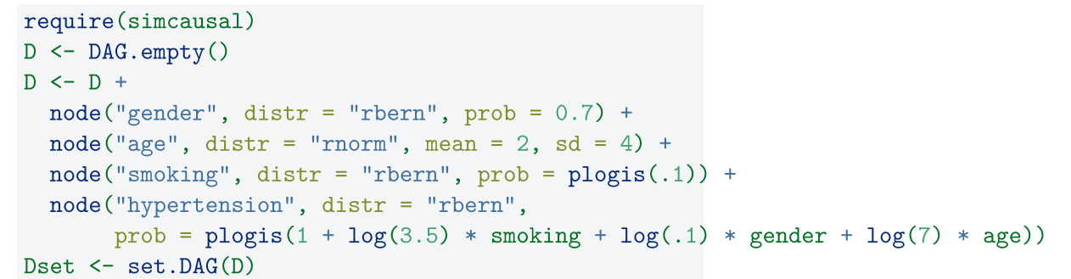
Collapsibility
A measure of association (say, risk diff erence) is collapsible if the marginal measure of association is equal to a weighted average of the stratum-specifi c measures of association.
Odds ratio can be non-collapsible.
risk diff erence (RD) is a collapsible measure, the marginal and conditional estimate should be approximately the same.

Slide 14
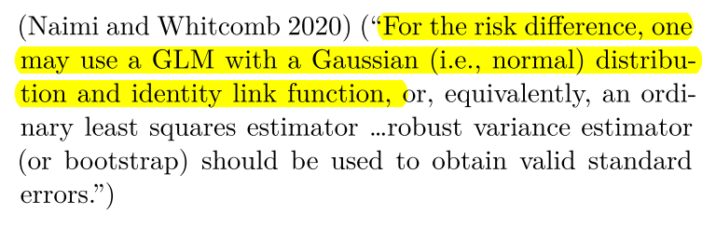
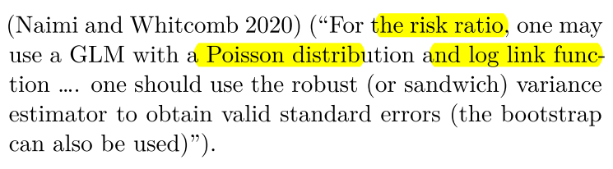
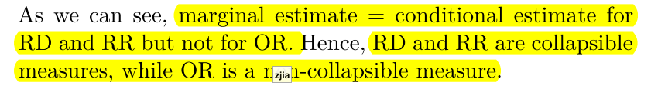

Slide 15
效应改变法（Change-in-Estimate,CIE）

Slide 16
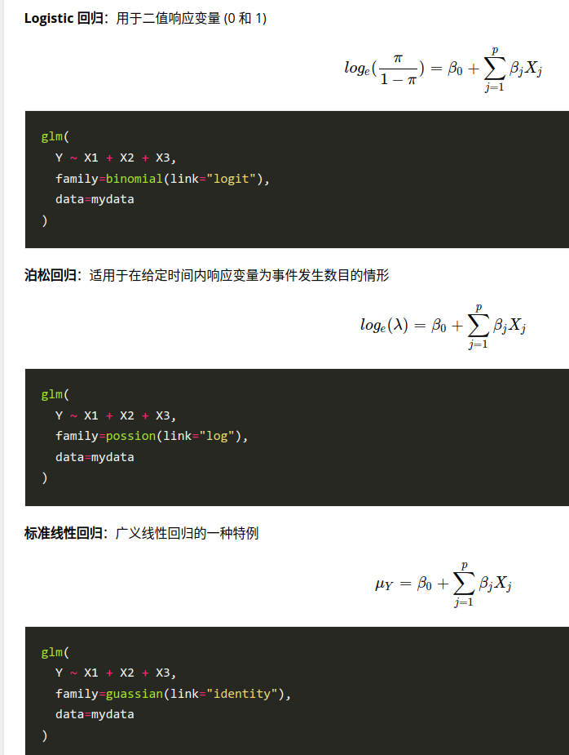
当出现过度离势时，仍可使用glm()函数拟合Logistic回归，但此时需要将二项分布改为类二项分布（quasibinomial distribution）。
https://blog.perillaroc.wang/post/2021/02/2021-02-18-r-in-action-chap13-glm/

Slide 17
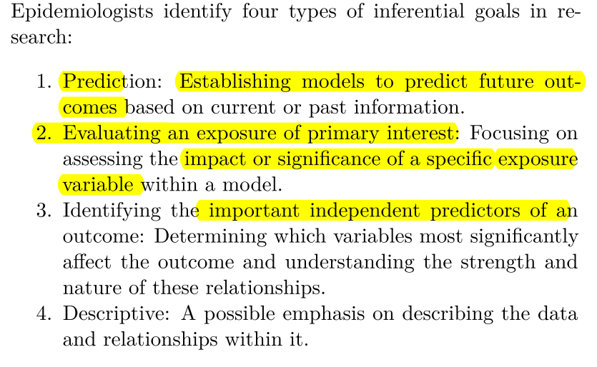
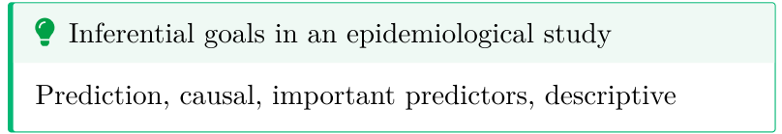

Slide 18
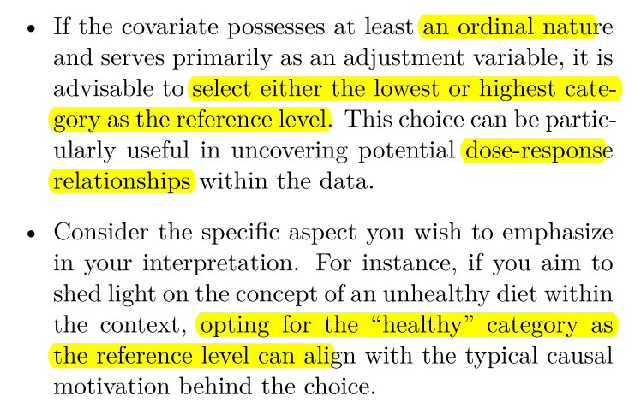
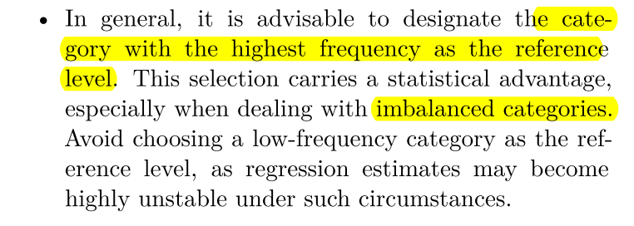
Criteria to determine the appropriate reference level for a categorical covariate:

Slide 19
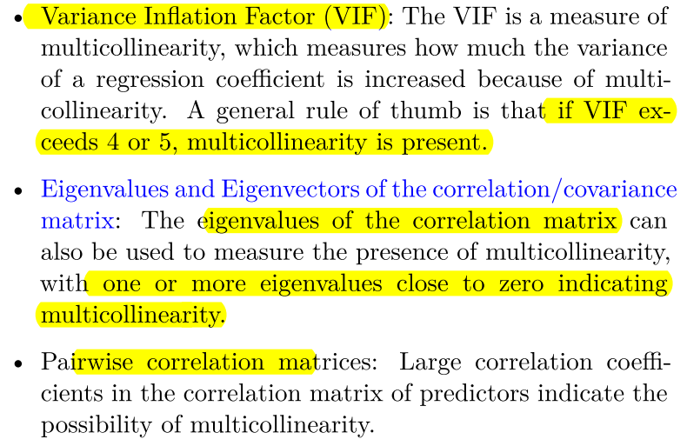
Multicollinearity Diagnostics

Slide 20
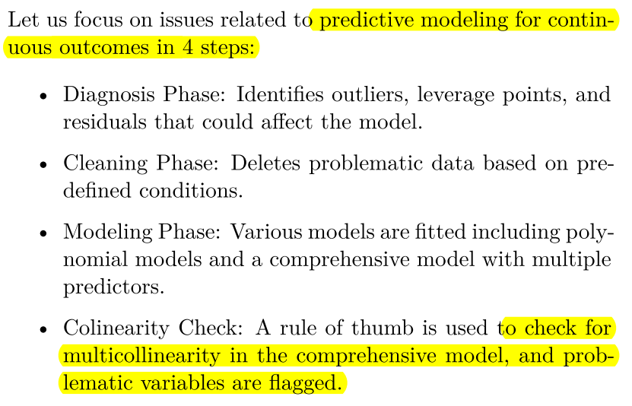

Slide 21
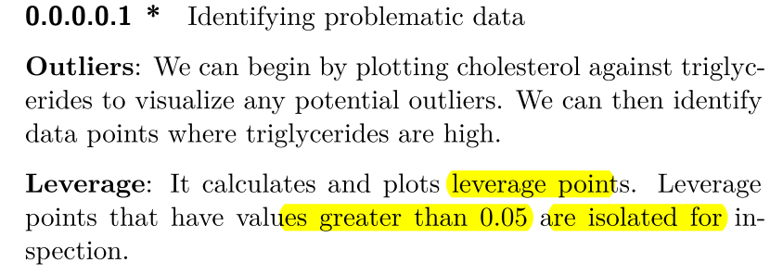
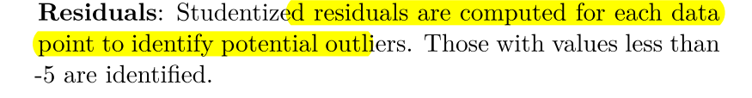
Diagnosis

Slide 22
Design-based analysis Vs model-based analysis
Design-based analysis differs from model-based analysis in its approach to handling survey data.
Design-based analysis emphasizes the importance of the survey’s sampling method and structure, focusing on representativeness and accurate variance estimation according to how the data was collected. It accounts for the complexities of the sampling design, e.g., stratification and clustering, to ensure that results are representative of the entire population.
model-based analysis uses statistical models to understand relationships and patterns, assuming data come from a specific distribution and often relying on random sampling.

Slide 23
survey features such as weights, strata, and clusters
Survey weights adjust for unequal probabilities of selection and nonresponse, ensuring that the sample represents the population accurately.
Stratification improves precision and representation of subgroups,
while clustering, often used for practicality and cost considerations, must be accounted for to avoid underestimating standard errors.
These features are vital in design-based analysis to provide unbiased, reliable estimates and are what fundamentally distinguish it from model-based approaches, which may not reflect the difficulties of complex survey structures.

Slide 24
Steps
PICOT
Subset the data (subset variables)
Making variable names the same
Variables, Covariates code
Dimension testing
Check the data for missingness
Look for zero-cells
Set appropriate reference
Complete data options
Fixing variable types
Setting Design
Bivariate analysis (Stratified by exposure & outcome)
Testing association (Rao-Scott and Thomas-Rao modifications Chi-square tests )
Regression

Slide 25
Performance
Pseudo-R-square values indicate how much of the total variability in the outcomes is explainable by the fi tted model (analogous to R-square).
1. Cox/Snell (never reaches max 1)
2. Nagelkerke R-square (scaled to max 1)
For a continuous outcome, we can compute R-square.
AUC is a measure to evaluate the predictive accuracy of the model,
Archer and Lemeshow test is a statistical test to evaluate how well your ( greater than 0.05 means that there is no evidence of lack of fi t to this model.)
AIC值越小，表示模型的拟合效果越好，同时模型的复杂度也较低。

Slide 26
Missing Data Analysis
Missing Completely at Random (MCAR)
missing is completely random and not related to any measured or unmeasured variables.
Missing at Random (MAR)
missing data is related to variables that are observed
Not Missing at Random (NMAR)
missing data is related to variables that are not observed.

Slide 27
The “Predictive Mean Matching” (PMM) method in Multiple Imputation (MI) is a widely used technique to handle missing data, particularly well-suited for continuous variables.
Multiple imputation then delete (MID):
MID is a specific approach used in the context of multiple imputation (MI) when dealing with missing outcome data. All missing values, including those in the outcome variable, are imputed to create several complete datasets. In subsequent analyses, the imputed values for the outcome variable are deleted, so that only observed outcome values are analyzed. Each dataset (with observed outcome values and imputed predictor values) is analyzed separately, and results are pooled to provide a single estimate.

Slide 28
standardized mean diff erences (SMD)
Standardized mean differences: SMD is a versatile and widely used statistical measure that facilitates the comparison of groups in research by providing a scale-free metric of difference and balance. In the context of propensity score matching, achieving low SMD values for covariates after matching is crucial to ensuring the validity of causal inferences drawn from the matched sample.
Benifits:
SMD is not influenced by the scale of the measured variable, making it suitable for comparing the balance of different variables measured on different scales.
Unlike hypothesis testing, SMD is not affected by sample size, making it a reliable measure for assessing balance in matched samples.

Slide 29
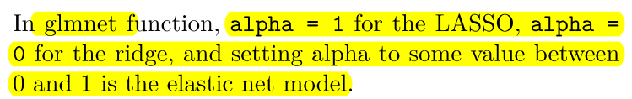
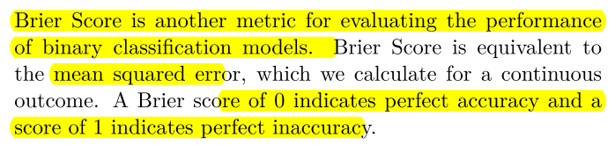
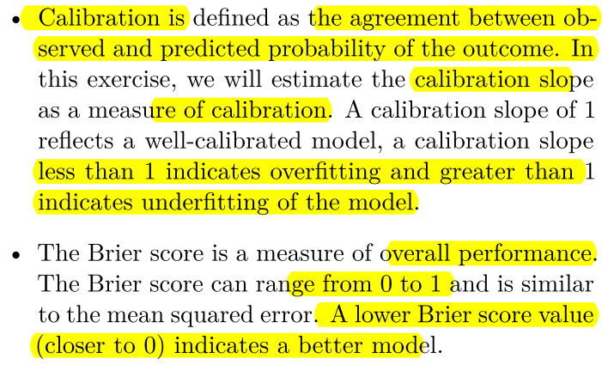

Slide 30
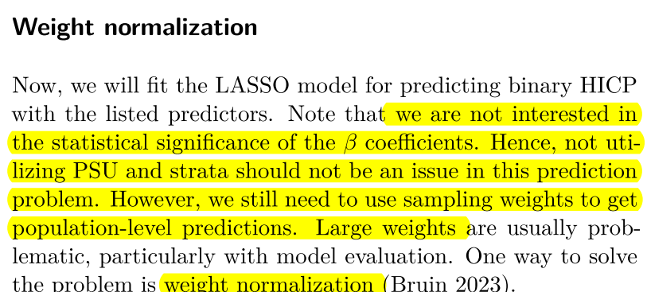

Slide 31
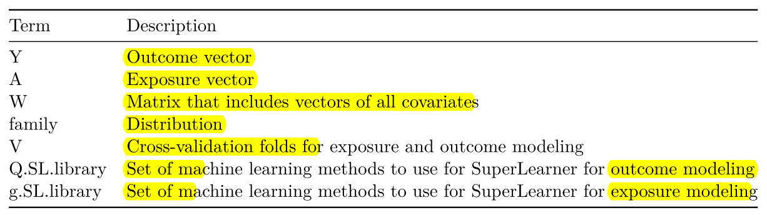
TMLE

Slide 32
